Slide 1
Darwin Core
Terms and Record Types
Notes:
From the very beginning, OBIS has championed the use international standards for biogeographic data. Without agreement on the application of standards and protocols, OBIS would not have been able to build a large central database. We are going to review the standards accepted by OBIS working through Darwin Core through out the rest of today, first with Darwin Core.

Slide 2

DarwinCore
Body of standards, including a glossary of terms to facilitate sharing of biodiversity information
Managed by Biodiversity Information Standards (TDWG)
Versions
Darwin Core 1.0 (1998)
Darwin Core 1.2 (2001) – OBIS Extension of DwC 1.2
Darwin Core 1.4 (2005)
ratified Darwin Core (2009) – OBIS transitioned to ratified DwC in 2013
Simple Darwin Core
Terms definitions: http://rs.tdwg.org/dwc/terms
For a list of Darwin Core terms in use by OBIS (and GBIF) see http://rs.gbif.org
Notes:
Darwin Core is a body of standards for biodiversity informatics. It provides stable terms and vocabularies for sharing biodiversity data. Darwin Core is maintained by TDWG (Biodiversity Information Standards, formerly The International Working Group on Taxonomic Databases).
We are going to go through the Darwin Core terms, both those required by obis, and the optional ones. We will look at how those terms are defined, their guidelines for use, and tools available to help populate certain of the terms accurately.
First a bit of history:
The old OBIS schema was an OBIS extension to Darwin Core 1.2. It added some terms which were important for OBIS, but were not supported by Darwin Core at the time (e.g. start and end date and start and end latitude and longitude, depth range, lifestage and terms for abundance, biomass and sample size).
In 2009, the Executive Committee of TDWG announced their ratification of an updated version of Darwin Core as a TDWG Standard. Ratified Darwin Core unifies specializations and innovations emerge from diverse communities, and provides guidelines for ongoing enhancement. The Darwin Core Quick Reference Guide links to TDWG’s term definitions and related practices for Ratified Darwin Core.
In December 2013, the 3rd session of the IODE Steering Group for OBIS agreed to transition OBIS globally to the TDWG-Ratified version of Darwin Core, and the mapping of the (old) OBIS specific terms to Darwin Core can be found here.
Simple Darwin Core is a predefined subset of the terms that have common use across a wide variety of biodiversity applications. The terms used in Simple Darwin Core are those that are found at the cross-section of taxonomic names, places, and events that document biological occurrences on the planet. The two driving principles are simplicity and flexibility.
[click] joke

Slide 3
DwC and OBIS - Required Terms
Eight required DwC terms for an OBIS contribution:
occurrenceID
- institutionCode + collectionCode + catalogNumber
eventDate
- uses the ISO 8601 standard, yyyy-mm-ddThh:mm:ss
decimalLongitude, decimalLatitude
- spatial reference system EPSG:4326
scientificName
- originally recorded, highest precision possible
scientificNameID
- from WoRMS
occurrenceStatus
- presence/absence of taxon at location
basisOfRecord
- specimen preserved? If so where. Human or Machine Observation
Notes:
This is an overview of the minimum terms to submit to OBIS, since the idea is to preserve and publish data, all fields should be mapped, but if this info isn’t there, then it needs to be created/determined.
OBIS currently has eight required DwC terms:
occurrenceID, eventDate, decimalLongitude, decimalLatitude, scientificName, scientificNameID, occurrenceStatus, basisOfRecord.
occurrenceID could be constructed by combining the institutionCode, the collectionCode and the catalogNumber
basisOfRecord - specimen preserved, need information about where it is stored, collection etc
No specimen preserved - HumanObservation vs MachineObservation
occurrenceID could be constructed by combining the institutionCode, the collectionCode and the catalogNumber
basisOfRecord - specimen preserved, need information about where it is stored, collection etc
No specimen preserved - HumanObservation vs MachineObservation

Slide 4
DwC Taxonomy and Identification
Terms
scientificName
scientificNameID
scientificNameAuthorship
kingdom, phylum, ... : useful to discriminate homonyms
taxonRank
identifiedBy : e.g. Person or machine
dateIdentified: use ISO 8601 (shown later)
identificationReferences: e.g. field guides…
identificationRemarks : e.g. Identification methods
identificationQualifier
scientificName | scientificNameID | Recorded sciName
Eualus gaimardii belcheri | 158358 | Eualus gaimardii belcheri
Eualus gaimardii belcheri | 158358 | Eualus belcheri
Eualus gaimardii belcheri | 158358 | Eualus belcherii
Notes:
scientificName (required term) should always contain the originally recorded scientific name, even if the name is currently a synomym.
This is necessary to be able to track back records to the original dataset. The name should be at the lowest possible taxonomic rank, preferably at species level or lower, but higher ranks, such as genus, family, order, class etc are also acceptable.
scientificNameID should contain the LSID from WoRMS
Example: Eualus gaimardii belcheri http://www.marinespecies.org/aphia.php?p=taxdetails&id=158358 is the old accepted name for this sample.
it is now called Eualus belcheri but it is important to persist the old name, so the records, when searched, can reflect that connection.
(However if the scientific name is recorded as Eualus gaimardii belcherii, that is an error and needs to be corrected)
It is recommended to not include authorship in scientificName, and only use scientificNameAuthorship for that purpose.
The scientificName term should only contain the name and not identification qualifications (such as ?, confer or affinity), which should instead be supplied in the IdentificationQualifier term.
taxonRemarks can capture comments or notes about the taxon or name.
kingdom and taxonRank can help us in identifying the provided scientificName in case the name is not available in WoRMS.
kingdom in particular can help us find alternative genus-species combinations and avoids linking the name to homonyms.
OBIS recommends providing information about how an identification was made, for example by which ID key, species guide or expert; and by which method (e.g morphology vs. genomics), etc.
The person’s name who made the taxonomic identification can go in identifiedBy and when in dateIdentified.
Use the ISO 8601:2004(E) standard for date and time, for instructions see Time.
A list of references, such as field guides used for the identification can be listed in identificationReferences.
Any other information, such as identification methods, can be added to identificationRemarks.
If the record represents a nomenclatural type specimen, the term typeStatus can be used, e.g. for holotype, syntype, etc.

Slide 5
DwC Taxonomy and Identification
scientificName
lowest level taxonomic rank that can be determined
no identification qualifiers (cf., aff.), see identificationQualifier
OBIS recommended practice: no authorship
scientificNameID
WoRMS LSID, no matter if the taxonomic status is accepted or not. Double check if authority and kingdom are correct
urn:lsid:marinespecies.org:taxname:141433
Examples
scientificName | scientificNameID | identificationQualifier
Peltodoris atromaculata | urn:lsid:marinespecies.org:taxname:509315
Peltodoris | urn:lsid:marinespecies.org:taxname:225423 | cf. atromaculata
Notes:
In case of uncertain identifications, and the scientific name contains qualifiers such as cf., ? or aff., then this name should go in identificationQualifier, and scientificName should contain the name of the lowest possible taxon rank that refers to the most accurate identification.
E.g. if the specimen was accurately identified down to genus level, but not species level, then the scientificName should contain the name of the genus, the scientificNameID should contain the LSID the genus and the identificationQualifier should contain the uncertain species name combined with ? or other qualifiers.
It is recommended to not include authorship in scientificName, and only use scientificNameAuthorship for that purpose.
The scientificName term should only contain the name and not identification qualifications (such as ?, confer or affinity), which should instead be supplied in the IdentificationQualifier term, see example below.
A WoRMS LSID should be added in scientificNameID (required term), OBIS will use this identifier to pull the taxonomic information from the World Register of Marine Species (WoRMS) into OBIS, such as the taxonomic classification and the accepted name in case of invalid names or synonyms.
LSIDs are persistent, location-independent, resource identifiers for uniquely naming biologically significant resources.
More information on LSIDs can be found at www.lsid.info.
You can contact the WoRMS data management team (info@marinespecies.org) in case the scientificName is missing in WoRMS.

Slide 6
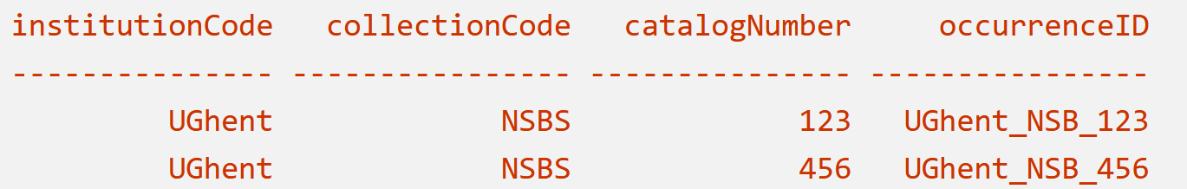
Occurrence
Terms
occurrenceID
institutionCode
collectionCode
catalogNumber
occurrenceStatus
organismQuantity
organismQuantityType
catalogNumber
preparations
typeStatus
associatedMedia
associatedReferences
associatedSequences
associatedTaxa
sex
lifeStage
behavior
occurrenceRemarks
recordedBy
Notes:
occurrenceID (required term) is an identifier for the occurrence record and should be persistent and globally unique. If the dataset does not yet contain (globally unique) occurrenceIDs, then they should be created. Can be constructed by combining the institutionCode, the collectionCode and the catalogNumber
Note that the inclusion of occurrenceID is also necessary for datasets in the OBIS-ENV-DATA format.
occurrenceStatus (required term) is a statement about the presence or absence of a taxon at a location. It is an important term, because it allows us to distinguish between presence and absence records. It is a required term and should be filled in with either present or absent.
A few terms related to quantity: organismQuantity and organismQuantityType, have been added to the TDWG ratified Darwin Core. This is a lot more versatile than the older individualCount field. However, OBIS recommends to use the Extended MeasurementorFact extension for quantitative measurements because of the standardization of terms and the fact that you can link these measurements to sampling events and factual sampling information.
Please take note that OBIS recommends all quantitative measurements and sampling facts to be treated in the ExtendedMeasurementOrFact extension and not in the Darwin Core files.
In the case specimens were collected and stored (e.g. museum collections), the catalogNumber and preparations terms can be used to provide the identifier for the record in the collection and to document the preparation and preservation methods. The term typeStatus see above (under identification) can be used in this context too.
Both associatedMedia, associatedReferences and associatedSequences are global unique identifiers or URIs pointing to respectively associated media (e.g. online image or video), associated literature (e.g. DOIs) or genetic sequence information (e.g. GenBANK ID).
associatedTaxa include a list (concatenated and separated) of identifiers or names of taxa and their associations with the Occurrence, e.g. the species occurrence was associated to the presence of kelp such as Laminaria digitata.
The recommended vocabulary for sex see BODC vocab : S10, for lifeStage see BODC vocab: S11, behavior (no vocab available), and occurrenceRemarks can hold any comments or notes about the Occurrence.
recordedBy can hold a list (concatenated and separated) of names of people, groups, or organizations responsible for recording the original Occurrence. The primary collector or observer, especially one who applies a personal identifier (recordNumber), should be listed first.

Slide 7
Occurrence - basisOfRecord
Terms
basisOfRecord
PreservedSpecimen: when specimen is deposited in a collection (please add institutionCode, collectionCode and CatalogNumber)
FossilSpecimen: important to distinguish collection date from geological time zone
LivingSpecimen: an intentionally kept/cultivated living specimen e.g. in an aquarium or culture collection
HumanObservation: e.g. bird sighting, benthic sample but specimens were discarded after counting
MachineObservation: sensors, e.g. DNA sequencers, image recognition
occurrenceStatus
Present or Absent (individualCount = 0)
Notes:
basisOfRecord (required term) specifies the nature of the record, i.e. whether the occurrence record is based on a stored specimen or an observation. In case the specimen is collected and stored in a collection (e.g. at a museum, university, research institute), the options are PreservedSpecimen (e.g. preserved in ethanol, tissue etc.), FossilSpecimen (fossil, which allows OBIS to make the distinction between the date of collection and the time period the specimen was assumed alive) or LivingSpecimen (an intentionally kept/cultivated living specimen e.g. in an aquarium or culture collection). In case no specimen is deposited, the basis of record is either HumanObservation (e.g bird sighting, benthic sample but specimens were discarded after counting), or MachineObservation (e.g. for occurrences based on automated sensors such as DNA sequencers, image recognition etc).
When the basisOfRecord is a preservedSpecimen, LivingSpecimen or FossilSpecimen please also add the institutionCode, collectionCode and catalogNumber, which will enable people to visit the collection and re-examine the material. Sometimes, for example in case of living specimens, a dataset can contain records pointing to the origin, the in-situ sampling position as well as a record referring to the ex-situ collection. In this case please add the event type information in type (see OBIS manual: event.)

Slide 8
Occurrence – Record Level Terms
Terms
basisOfRecord
institutionCode
collectionCode
catalogNumber
bibliographicCitation
modified
dataGeneralizations
Notes:
institutionCode identifies the custodian institute (often by acronym), collectionCode identifies the collection or dataset within that institute. Collections cannot belong to multiple institutes, so all records within a collection should have the same institutionCode. The catalogNumber is an identifier for the record within the dataset or collection.
bibliographicCitation allows for providing different citations on record level, while a single citation for the entire dataset can be provided in the metadata. modified is the most recent date-time on which the resource was changed. It is required to use the ISO 8601:2004(E) standard.
dataGeneralizations refers to actions taken to make the shared data less specific or complete than in its original form. Suggests that alternative data of higher quality may be available on request. This can be the case for occurrences of vulnerable or endangered species and their positions are generalized.

Slide 9
Location
Terms
decimalLongitude, decimalLatitude
coordinateUncertaintyInMeters
geodeticDatum
OBIS recommended practice: EPSG:4326
footprintWKT
continent, waterBody, islandGroup, island, country, municipality, ...
locality
most specific location description
locationID
for example MRGID from http://www.marineregions.org
minimumDepthInMeters, maximumDepthInMeters
Notes:
decimalLatitude and decimalLongitude (required terms) are the geographic latitude and longitude (in decimal degrees). For decimalLatitude, positive values are north of the Equator, negative values are south of it. All values lie between -90 and 90, inclusive. For decimalLongitude, positive values are east of the Greenwich Meridian, negative values are west of it. All values lie between -180 and 180, inclusive. The number of decimals should be appropriate for the level of uncertainty in coordinateUncertaintyInMeters (at least within an order of magnitude).
coordinateUncertaintyInMeters is the radius of the smallest circle around the given position containing the whole location.
The spatial reference system to be documented in geodeticDatum is EPSG:4326. OBIS has a tool to check coordinates or to determine coordinates for a location (point, transect or polygon) on a map. This tool also allows geocoding location names using marineregions.org.
The name of the place or location can be provided in locality, and if possible linked by a locationID using a persistent ID from a gazetter, such as the MRGID from MarineRegions.
footprintWKT is used to provide information about data collection from transects, polygons etc.
If the species occurrence only contains the name of the locality, but not the exact coordinates, a geocoding service can be used to obtain the coordinates. Marine Regions has a search interface for geographic names, and provides coordinates and often precision in meters, which can go into coordinateUncertaintyInMeters. Google maps could also be used to determine the decimal coordinates.
Additional information about the locality can also be stored in DwC terms such as waterBody, islandGroup, island and country. locationAccordingTo should provide the name of the gazetteer that is used to obtain the coordinates for the locality.
locationID is an identifier for the set of location information (e.g. station ID, or MRGID from marineregions), for example the Balearic Plain has MRGID: http://marineregions.org/mrgid/3956.
Keep in mind while filling in minimumDepthInMeters and maximumDepthInMeters that this should be the depth at which the sample was taken and not the water column depth at that location.

Slide 10
Location
Before conversion to decimals | In decimal format
18°30’25’’N – 5°15’E | 18.51; 5.25
54,23N – 16,5S | 54.23 ; -16.5
Possible issues with coordinates
S and W coordinates missing minus sign
Latitudes and Longitudes are switched
Not in decimal degrees
-150.244.444.444.444
34.5673°
14°35’26’’N
Values outside EPSG:4326 bounds (Lon: -180 to 180 and Lat: -90 to 90)
-551.675
Number format (dot as comma separator)
-54,3212

Slide 11
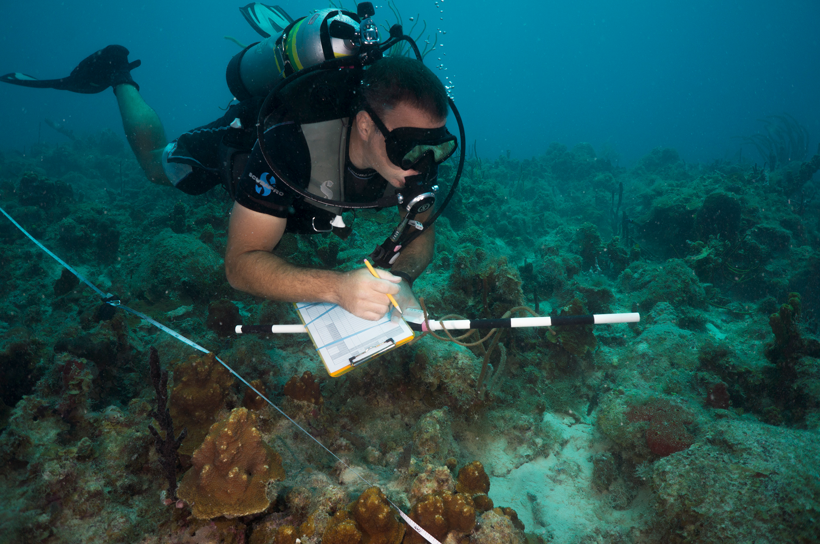
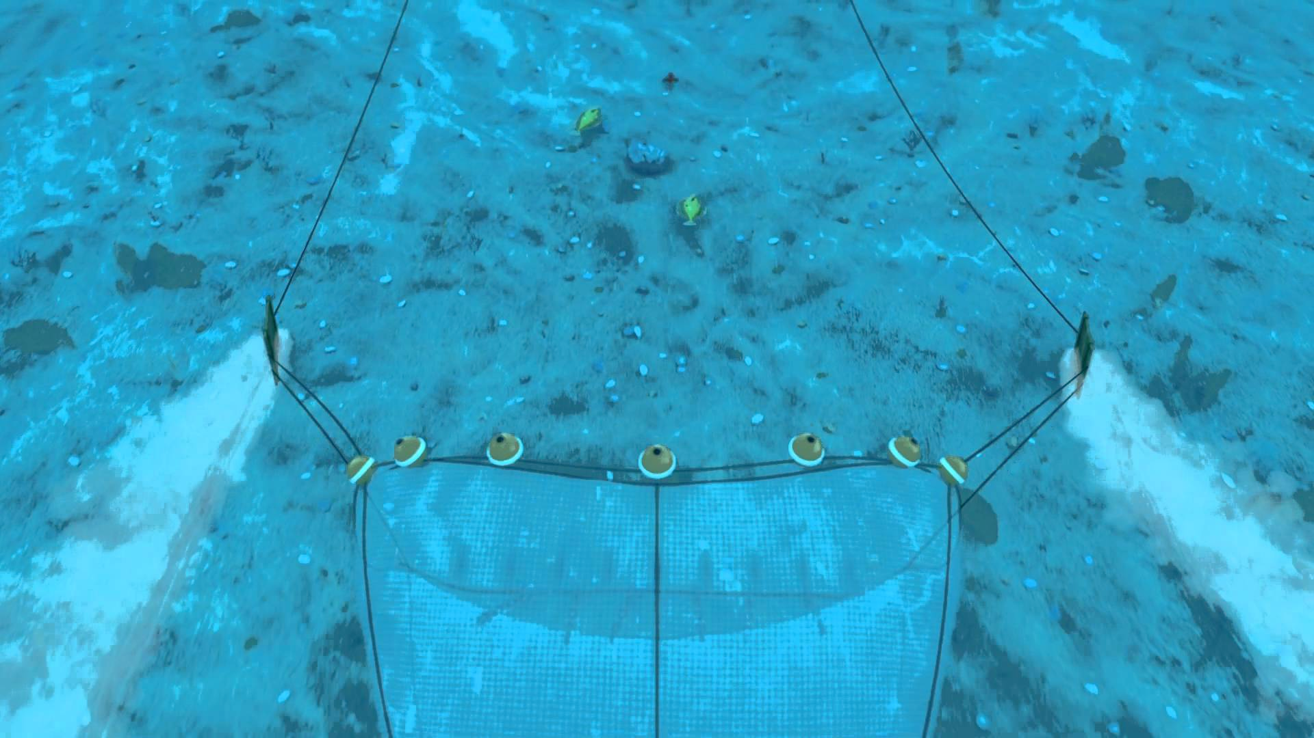
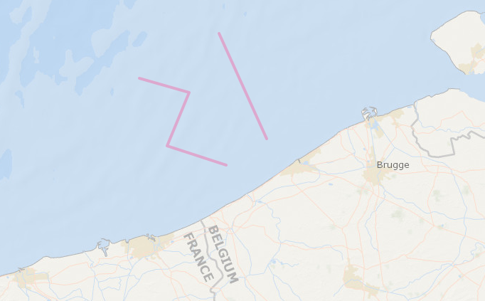
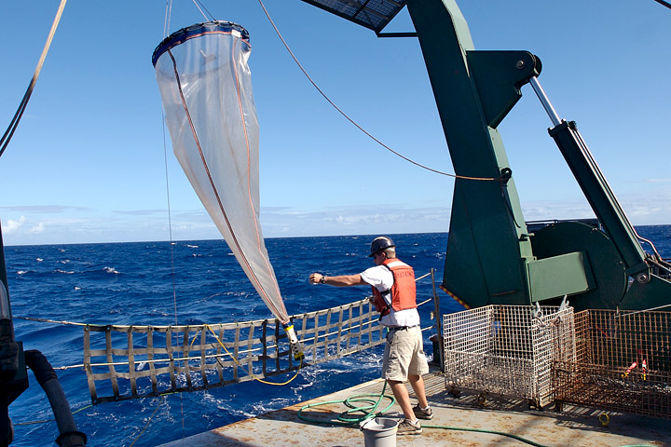
Location
footprintWKT: transects
LINESTRING (2.80151 51.28597, 2.61749 51.53950)
LINESTRING (2.64496 51.22237, 2.41699 51.26879, 2.50214 51.39749, 2.30988 51.43175)
Notes:
A Well-Known Text (WKT) representation of the shape of the location can be provided in footprintWKT. This is particularly useful for tracks, transects, tows, trawls, habitat extent or when an exact location is not known.
There is an R tool to calculate the centroid and radius for WKT polygons.

Slide 12
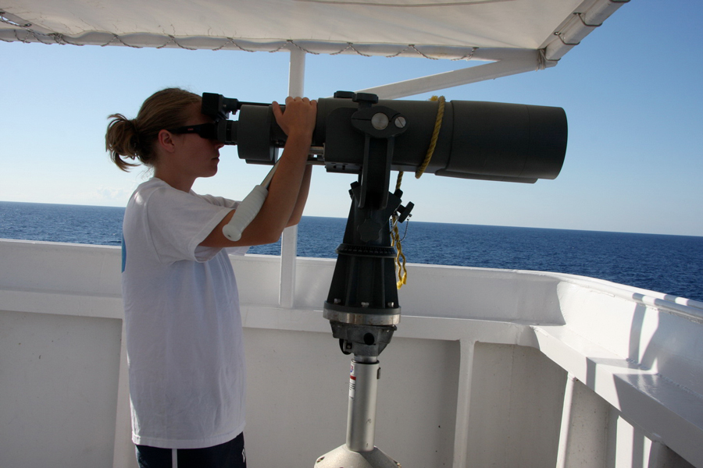
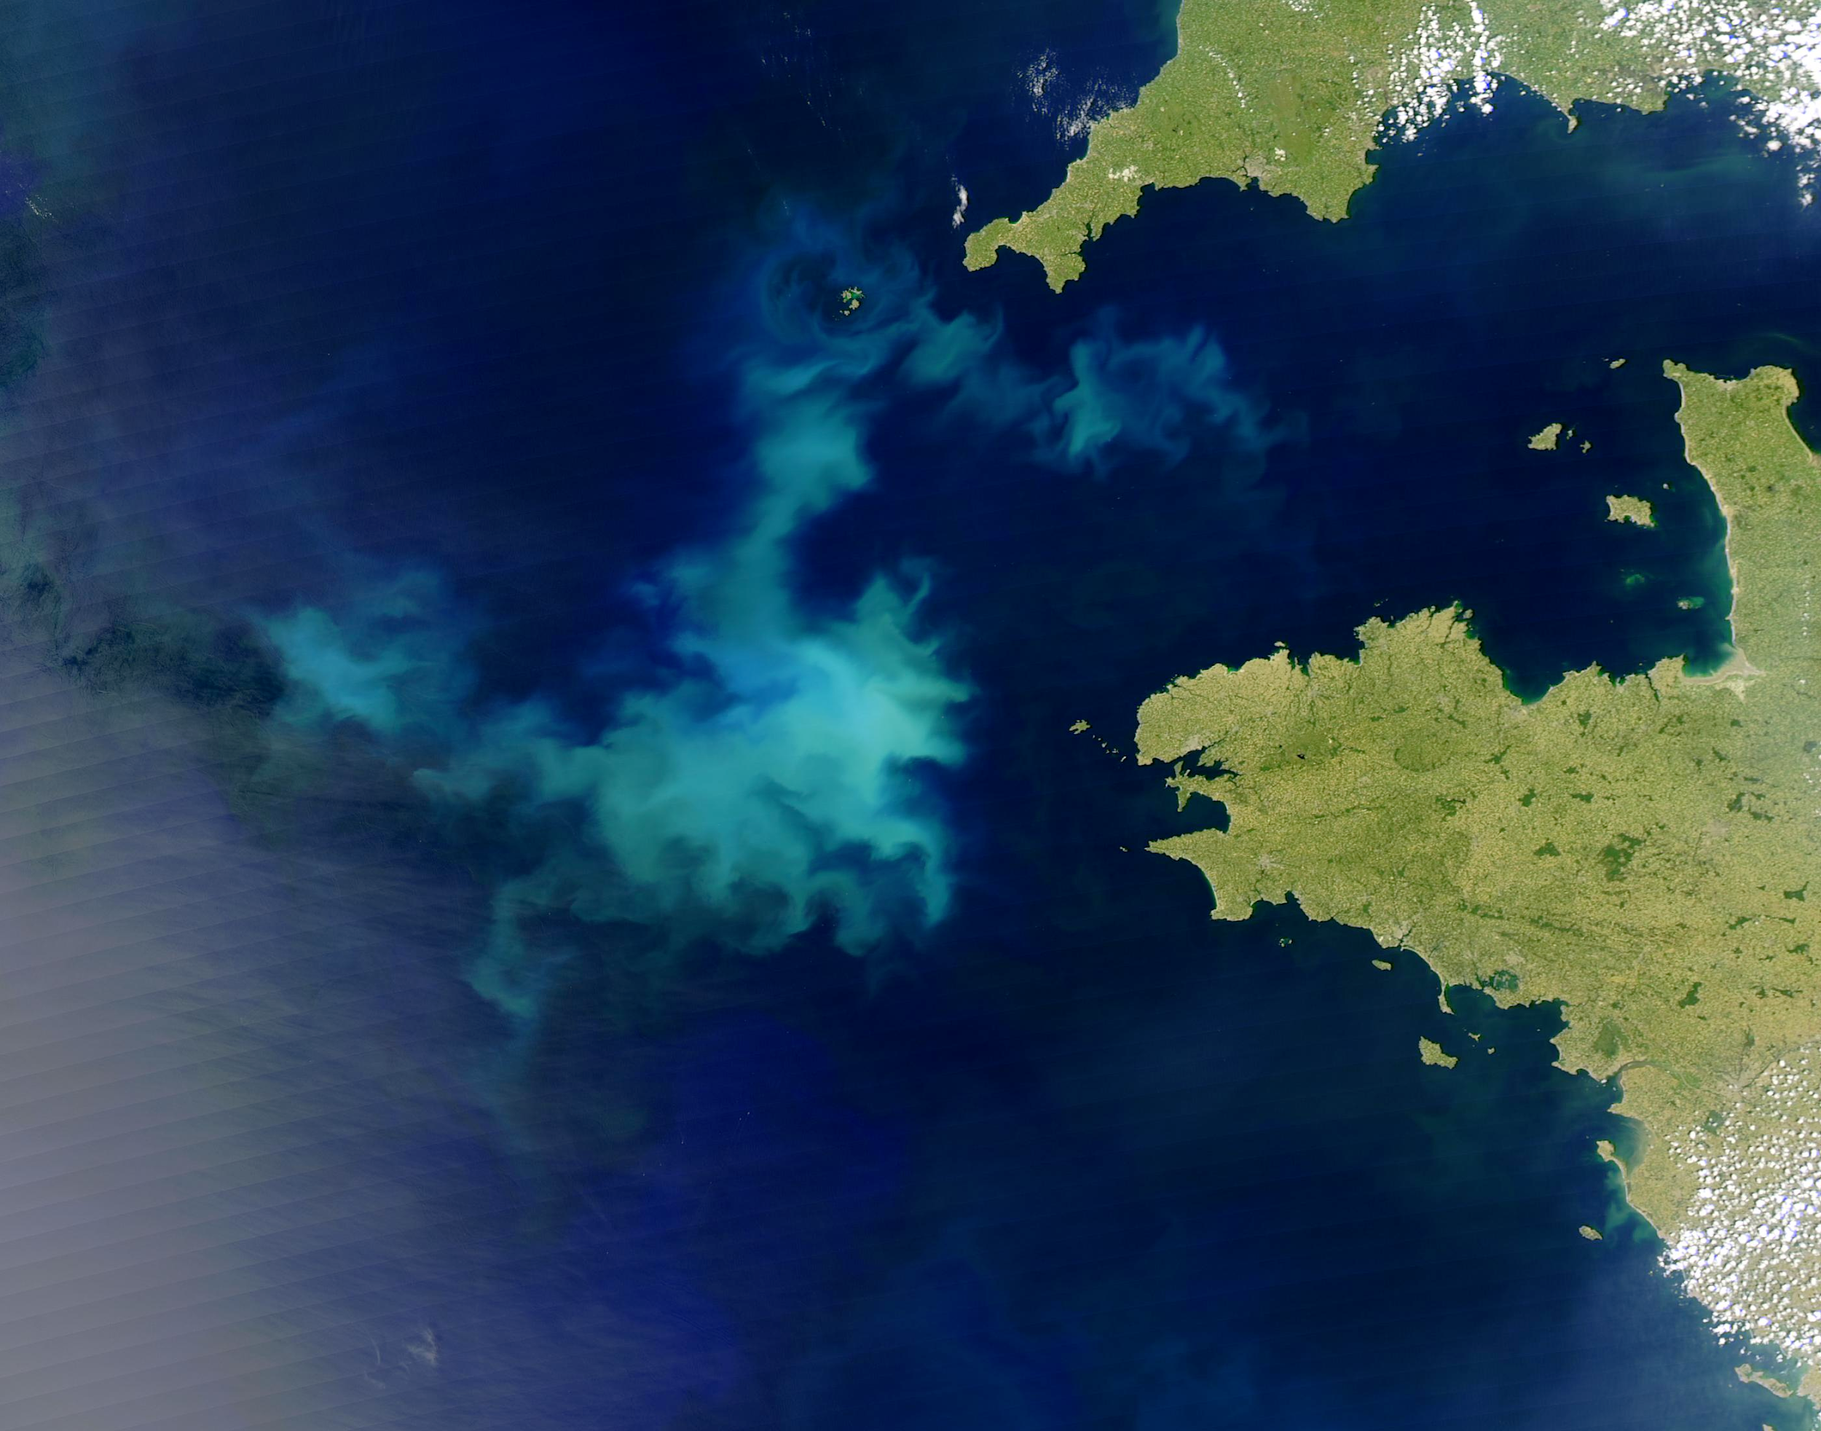
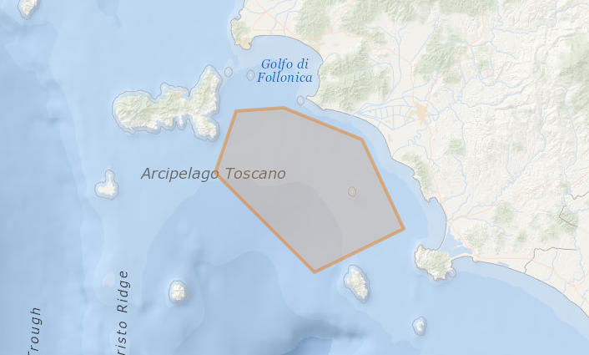
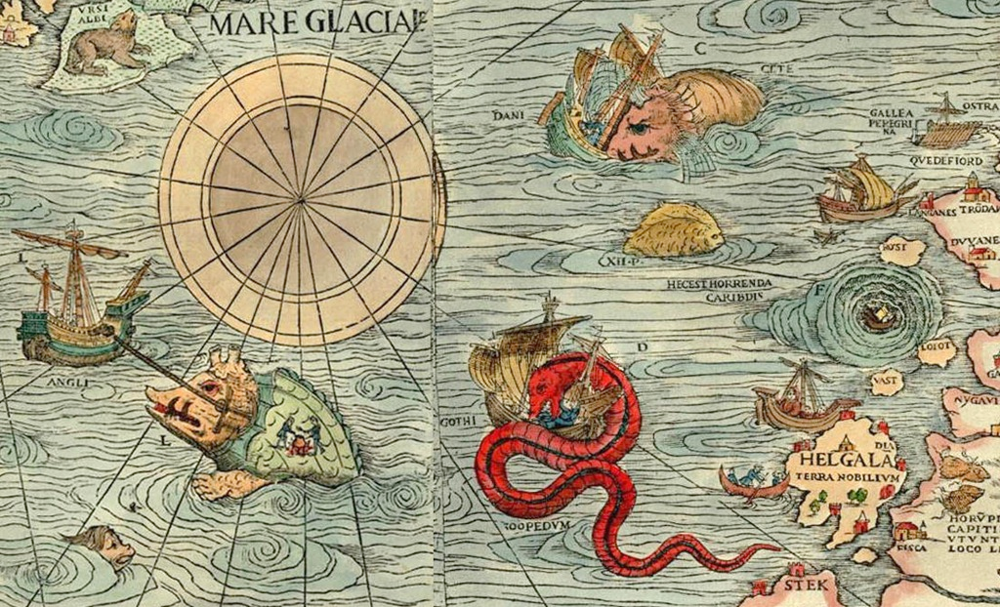
Location
footprintWKT: polygons
POLYGON ((10.65674 42.77928, 10.50018 42.77121, 10.43152 42.62183, 10.75836 42.38087, 11.05225 42.48628, 10.91492 42.70262, 10.65674 42.77928))

Slide 13
Location
Examples
locality | locationID | decimal Longitude | decimal Latitude | coordinate Uncertainty InMeters | minimum Depth InMeters | maximum Depth InMeters | footprint WKT
Ha Long Bay | MRGID:8897 | 107.1 | 20.9 | 26000
station_115 |  | 2.6999 | 51.2219 | 50 | 30 | 30
 |  | 2.5996 | 51.2765 | 8134 | 5 | 10 | LINESTRING (2.53510 51.21549, 2.66418 51.33748)
Notes:
Three examples of location information, as much information as possible should be included in the record.

Slide 14
Event
eventID
parentEventID
materialSampleID
habitat
Notes:
eventID is an identifier for the sampling or observation event.
parentEventID is an identifier for a parent event, which is composed of one or more sub-sampling (child) events (eventIDs). eventID can be used for replicate samples or sub-samples. Make sure each replicate sample receives a unique event ID, which could be based on the unique sample ID in your dataset (which can also be in recorded in materialSampleID). OBIS does not need to have separate eventIDs and materialSampleIDs, rather OBIS can treat these two terms as equivalent. The unique sample ID for each physical sample or subsample at each location and time is highly recommended information for sample tracebility and data provenance. Repeating the parentEventID in the child event (use : as delimiter) will make the structure of the dataset easier to understand.
habitat is a category or description of the habitat in which the Event occurred (e.g. seamount, hydrothermal vent, seagrass, rocky shore, intertidal, ship wreck etc.)

Slide 15
Time
Terms
eventDate
verbatimEventDate (not recommended)
ISO 8601
1973-02-28T15:25:00
1973-02-28
1973-02
1973
1973-02-28T15:25:00Z (UTC)
1993-01-26T04:39+12/1993-01-26T05:48+12
2015-023
2014-W26
Notes:
When it comes to recording time values, or date time values rather, there are multiple accepted formats, depending on the resolution of the value.
The date and time at which an occurrence was recorded goes in eventDate. This term uses the ISO 8601 standard. OBIS recommends using the extended ISO 8601 format with hyphens.
ISO 8601 dates can represent moments in time at different resolutions, as well as time intervals, which use / as a separator. Date and time are separated by T. Times can have a time zone indicator at the end, if this is not the case then the time is assumed to be local time. When a time is UTC, a Z is added. Some examples of ISO 8601 dates are:
Besides year, month and day numbers, ISO 8601 also supports ordinal dates (year and day number within that year) and week dates (year, week, and day number within that week). These dates are less common and have the formats YYYY-DDD (for example 2015-023) and YYYY-Www-D (for example 2014-W26-3).
ISO 8601 durations should not be used.

Slide 16
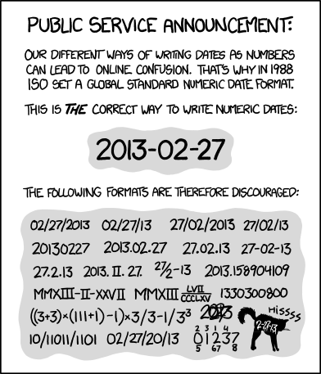
Time
Not ok:
2015/07/11
1915-6-9 0:00:00
1995-7-0
09-Dec-2009
10-01-2013
1:25
00:18:00+0:00
Jan
Notes:
There are also some frequently used formats that are not acceptable, as they are ambiguous, incomplete, (or a cat).

Slide 17
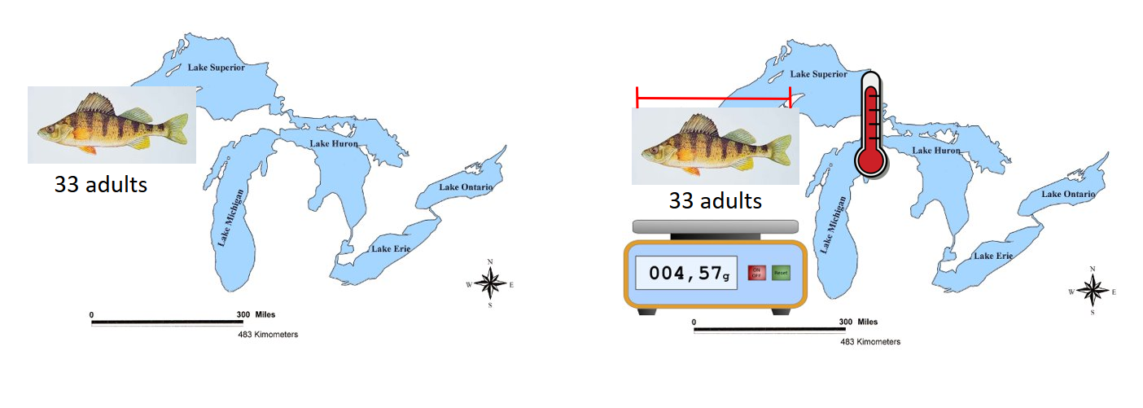
Occurrence vs Event - Trawl Survey
Occurrence Only
OBIS ENV data
Notes:
Lets look at an example of a trawl survey on the great lakes.

Slide 18
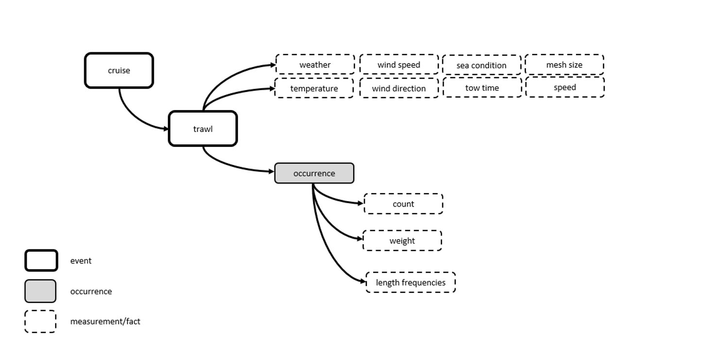
Occurrence vs Event
Notes:
When to use Event Core
When the dataset contains abiotic measurements, or other biological measurements which are related to an entire sample (not a single specimen)
When specific details are known about how a biological sample was taken and processed. These details can be expressed using the eMoF and the newly developed Q01 vocabulary.
When to use Occurrence Core
No information on how the data was sampled or samples were processed.
No abiotic measurements are taken or provided
Biological measurements are made on individual specimens (each specimen is a single occurrence record)
This is often the case for museum collections, citations of occurrences from literature, individual sightings.

Slide 19
DwC Resources
Terms definitions: http://rs.tdwg.org/dwc/terms
Marine region gazetteer: http://www.marineregions.org
Git Hub https://github.com/tdwg/dwc
Coordinate converter: https://obis.shinyapps.io/coordinates/
Geomapping tool: http://iobis.org/maptool/
Notes:
Complete terms definitions are available at the tdwg website.
The marine region gazetteer is located at this link.
If you find that your type of study is not properly represented by the available terms, this type of thing is being actively discussed at the twdg/dwc github.
Tools for converting to decimal degrees, and for describing the footprintWKT are deprecated, however there are other methods for completing those tasks, including programmatic tools in R and other languages, be wary when using an online tool.

Slide 20
DarwinCore Quiz!
Notes:
QUIZ TIME

